Slide 1
MoBot
Your personalised newsbot

Slide 2
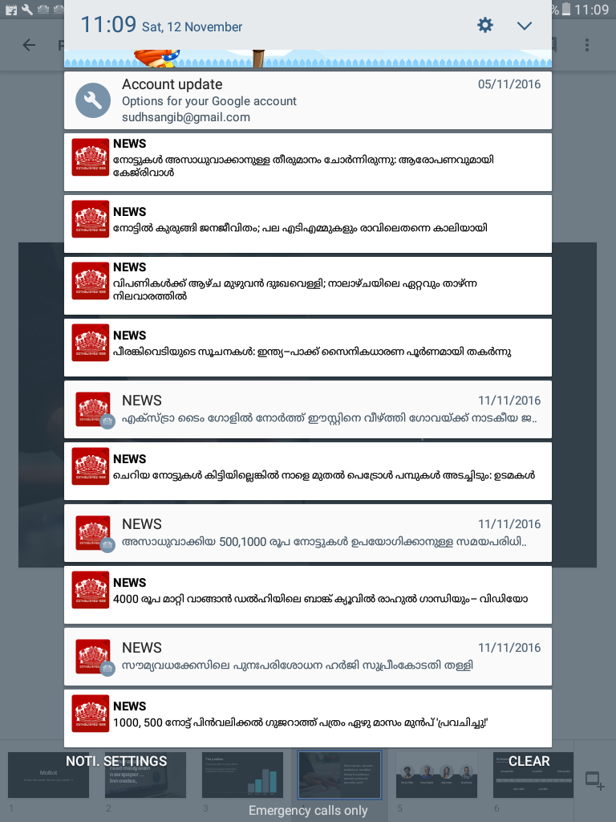

Slide 3
Problems
Overloading of device,with notification

Slide 4
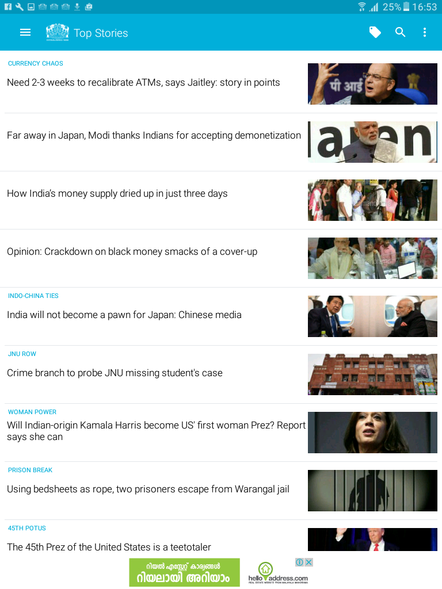
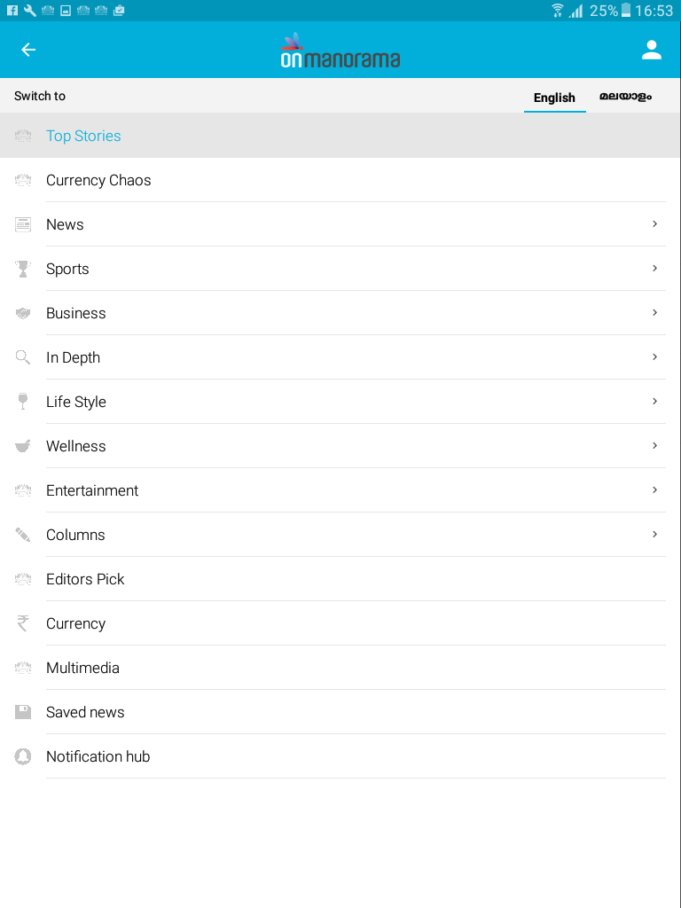
Time consuming searches,for favorate topics

Slide 5
Is there a solution ??

Slide 6
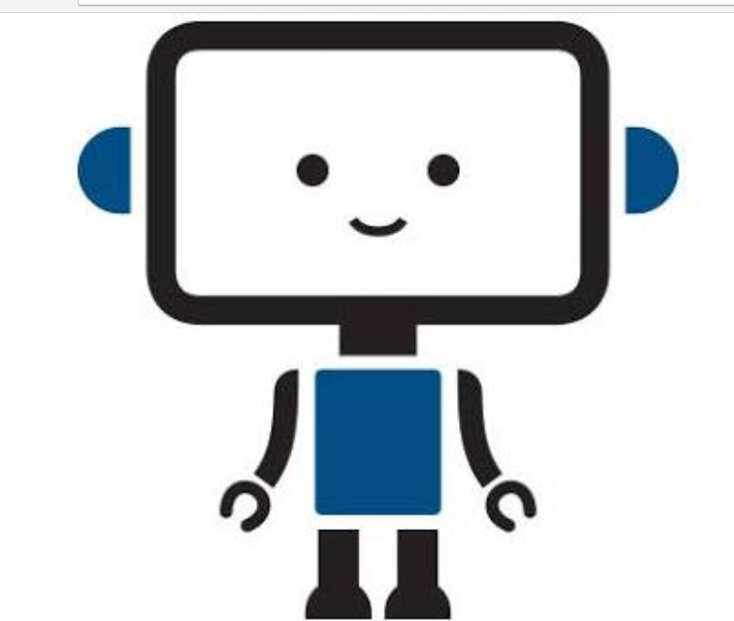
MoBot

Slide 7
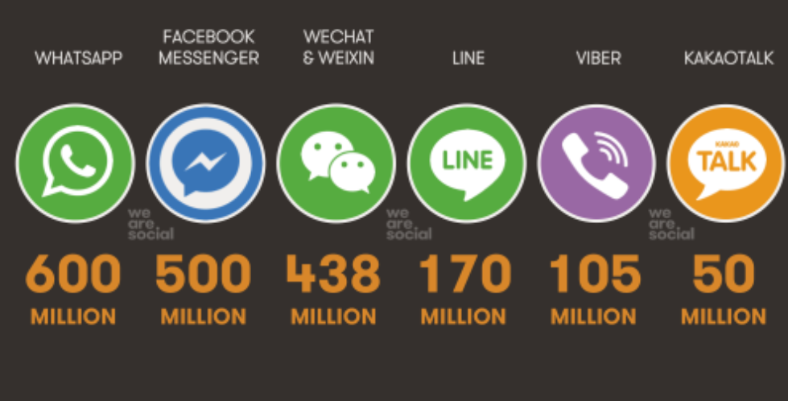

Slide 8
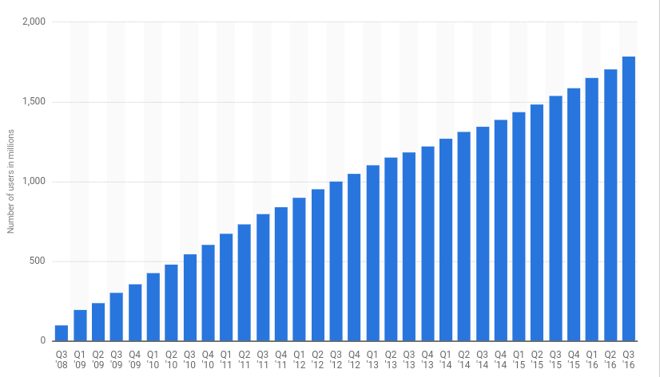

Slide 9
Free Version
Revenue model
Premium version

Slide 10


Bots and,machine learning are future of computer,industry and its,scope are raising day by day

Slide 11
Thank you ☺

